Slide 1
Differential Encoding of DFAs for Fast Regular Expresssion Matching
Author:
Domenico Ficara, Andrea Di Pietro, Stefano Giordano, Gregorio Procissi, Fabio Vitucci, and Gianni Antichi
Publisher: 2010 Transactions on Networking
Presenter: Yuen-Shuo Li
Date: 2013/12/4

Slide 2
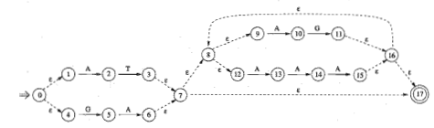
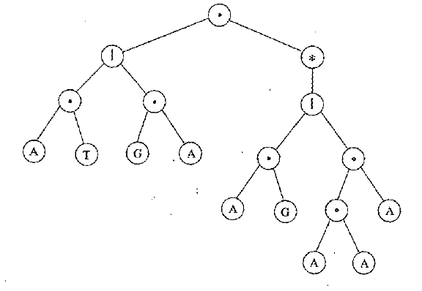
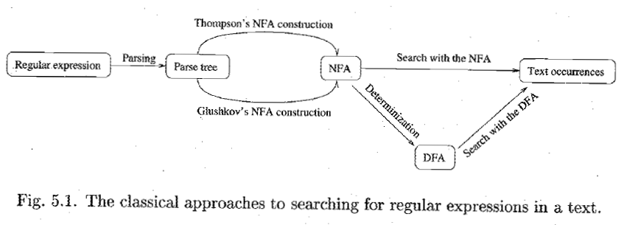

background
Notes:
NFA 的缺點是搜尋速度較慢，而 DFA的缺點是所需要記憶體較多
所以 DFA 的方法主要在嘗試減少 state 的個數或是 transition 的個數

Slide 3
introduction
This paper presents a new representation for DFAs, orthogonal to most of the previous solutions, called delta finite automata, which considerably reduces states and transitions while preserving a transition per character only, thus allowing fast matching.
A further optimization exploits Nth order relationships within the DFA by adopting the concept of “temporary transitions.”
Notes:
這篇 Paper 介紹了 delta fa 和它的優化版

Slide 4
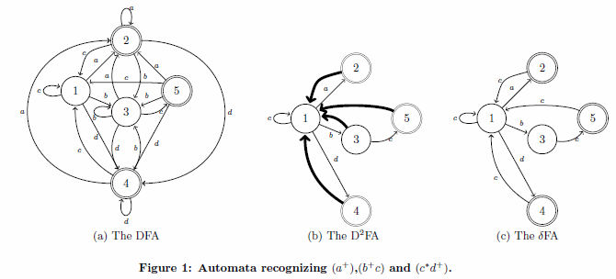
δFA
Delta-FA is based on the observation that since most adjacent states share several common transitions.
It is possible to delete most of them by taking into account the different ones only.
Notes:
這份 Paper 前半就是在講之前提的 Delta-FA，當複習快速看過

Slide 5
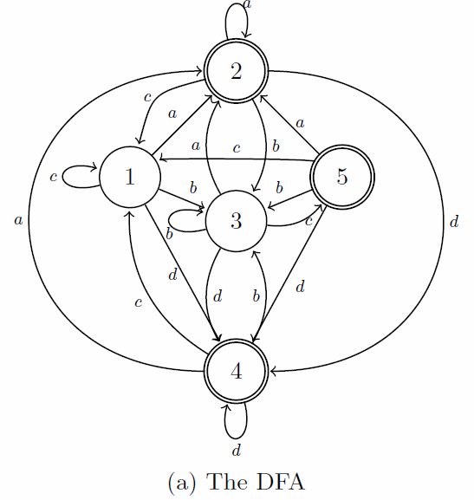
delta finite automaton
Observing the graph, it is evident that most transitions for a given input lead to the same state, regardless of the starting state
in particular, adjacent states share the majority of the next-hop states associated with the same input chars.
Notes:
觀察可以發現通常同一個 char 就會引導至同一個 state
甚至相連的 State 其 next-hop state 幾乎都是相同的

Slide 6
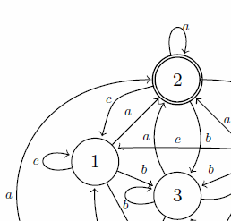
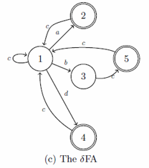
delta finite automaton
Then if we jump from state 1 to state 2 and we “remember" (in a local memory) the entire transition set of 1, we will already know all the transitions defined in 2 (because for each character they lead to the same set of states as 1).
This means that state 2 can be described with a very small amount of bits.
Notes:
也就是說只要記得上一個 state 的 transition set，就只要另外存不同的即可。
State 2 不用存 b，因為 State 1 有存。

Slide 7
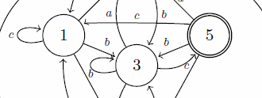
delta finite automaton
Instead, if we jump from state 1 to 3, and the next input char is c, the transition will not be the same as the one that c produces starting from 1; then state 3 will have to specify its transition for c.
Notes:
這裡的 State 3 之所以要存 c ，是因為和之前不同。

Slide 8
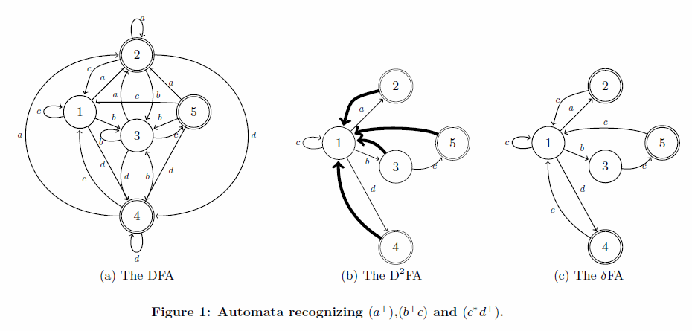
delta finite automaton
20 edges
9 edges
8 edges
δFA is to obtain a similar compression as D²FA without giving up the single state traversal per character of DFA.

Slide 9
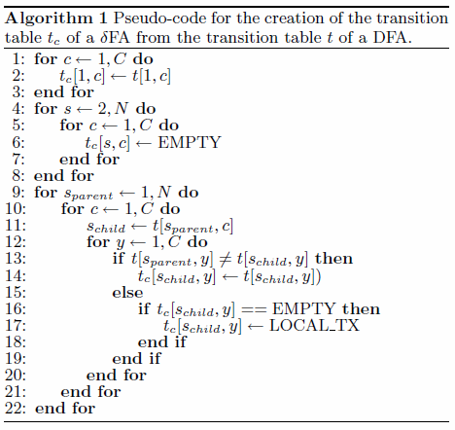
construction
Notes:
簡單來說，就是把 t[s, c] 壓縮成 t_{c}[s, c]
LOCAL_TX 代表空的
State 1 要全存
State 2 後先給空，再補上改變的 transition
(要保證每一個會到這個 State 的 transition 都是相同的，如果有不同，還是得存)

Slide 10
construction
After the construction procedure, since the number of transitions per state is significantly reduced, it may happen that some of the states have the same identical transition set.
If we find j identical states, we can simply store one of them, delete the other j-1 and substitute all the references to those with the single state we left.
Notice that this operation creates again the opportunity for a new state-number reduction, because the substitution of state references makes it more probable for two or more states to share the same transition set. Hence we iterate the process until the number of duplicate states found is 0.
Notes:
透過這個方法減少 transition 後，就可能會發現有些 state 的 transition set 完全相同，這樣一來，這相同 transition set 的 state 就可以合併成一個 state，進一步減少使用的記憶體。而這個過程可以一直重覆。

Slide 11
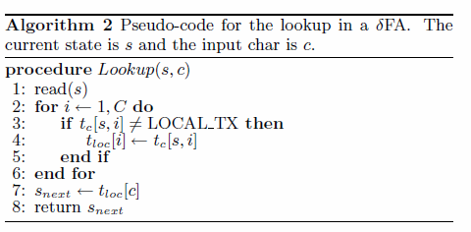
lookup
First, the current state must be read with its whole transition set(step 1).
Then it is used to update the local transition set t_{loc}: for each transition defined in the set read from the state, we update the corresponding entry in the local storage.
Finally the next state s_{next} is computed by simply observing the proper entry in the local storage t_{loc}.
Notes:
保證 transition set 每一個都是相同的，但是需要改才改

Slide 12
δ^{n}FA
Instead of specifying the transition set of a state with respect to its direct parents, the adoption of N-step “ancestors” increases the chances of compression. This is the approach of FA, which is an improved version of FA.

Slide 13
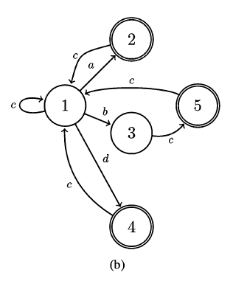
δ^{n}FA
In the example, all the transitions for character are specified for all the five states because of a single state 3 that defines a different transition.
This due to the strict definition of FA rules that do not “see” further than a single hop

Slide 14
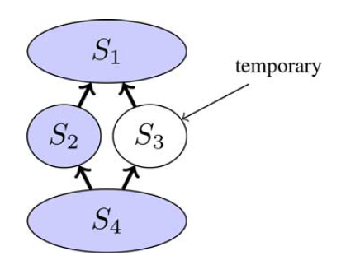
δ^{n}FA
A better approach is to define the transition for in state 3 as “temporary” in the sense that it does not get stored in the local transition set.
Same color means same transitions (for a given character)
This means that, whenever we read state 3, the transition for in the local transition set is not updated, but it remains as it was in its parents.

Slide 15
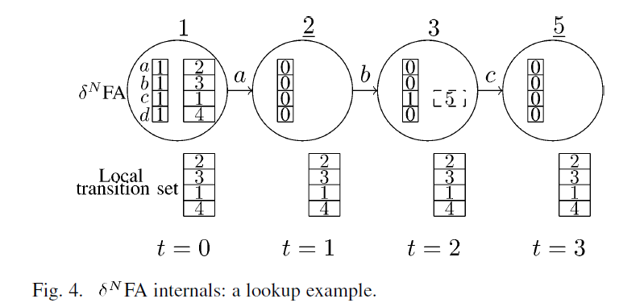
δ^{n}FA
The lookup in a δ^{n}FA differs very slightly from that of δFA. The only difference concerns temporary transitions, which are valid within their state, but they are not stored in the local transition set.

Slide 16
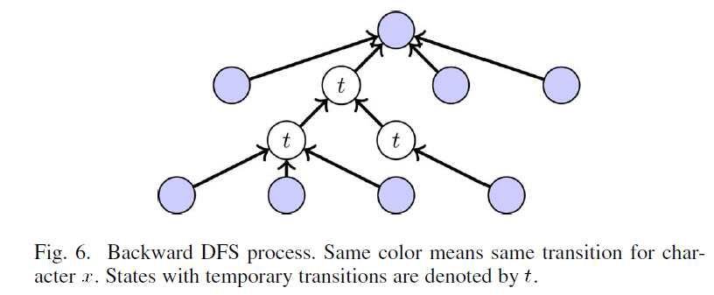
δ^{n}FA
In the construction phase, in order to recognize the nodes where a transition can be defined as temporary, for each char of each state s in the δ^{n}FA, a depth-first search (DFS) is performed.
The depth of the tree corresponds to the “order”i of the δ^{i}FA we are building.
The DFS walks through the δ^{n}FA backwards and halts when all the leaves are ancestor states that share the same transition.

Slide 17
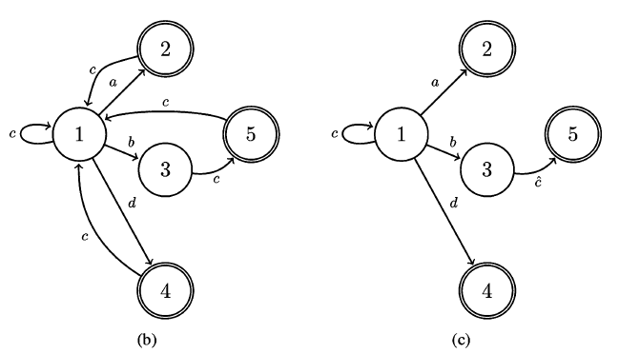
δ^{n}FA
all the transitions for in the internal nodes (nonleaves) of the DFS tree can be set as temporary.

Slide 18
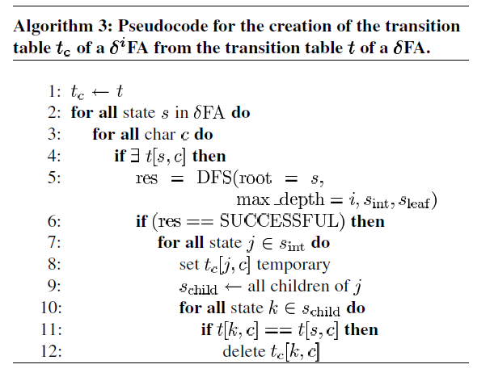
δ^{n}FA

Slide 19
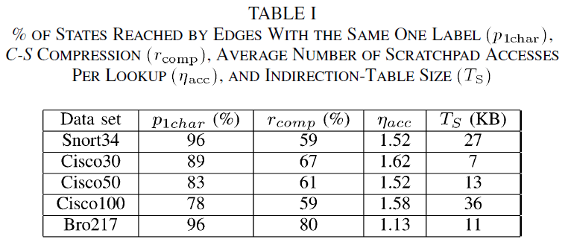
Compressing char-state pairs
C-S is based on the observation of rule sets: In most cases, the edges reaching a given state are labeled with the same character.

Slide 20
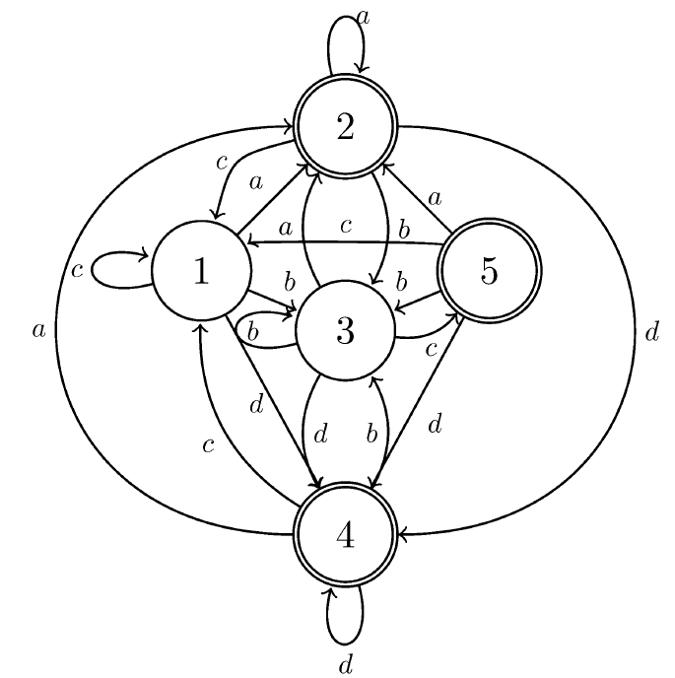
Compressing char-state pairs
A consistent number of states in the DFA can be associated with a single character and can be referred to by using a “relative" address.
Character a produces transitions to states 1 and 2 only. Therefore, 1 bit of rel-id suffices to encode its two possible next-states.
We only need to store two elements in the indirection table for the character a.

Slide 21
Compressing char-state pairs
The absolute address of the next state will be retrieved by using a small indirection table, which will be small enough to be kept in local memory, thus allowing for fast lookup.
During lookup, the character is adopted as column-index of the indirection table, and the rel-id as index of the row.
 | 0 | 1
a | State1 | state2
…

Slide 22
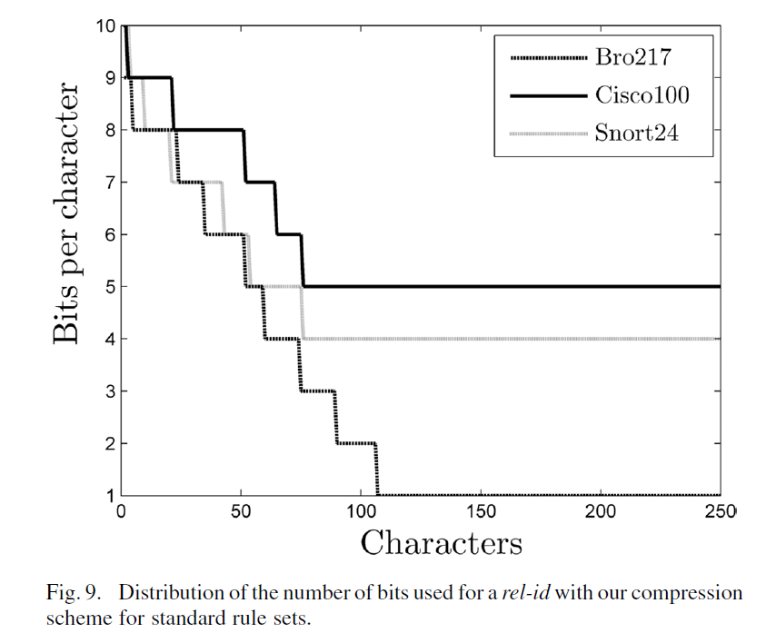
Compressing char-state pairs
Next state pointers are represented in most cases with very few bits (less than 5). Even in the worst case, the number of bits is always below 10.

Slide 23
Compressing char-state pairs
It is clear that such a table will suffer from a certain degree of redundancy.
Some states will be associated with several rel-ids, and their absolute address will be reported more than once.
 | 0 | 1
a | State1 | state2
…
c | state1 | state5
…

Slide 24
Compressing char-state pairs
Our simple solution is to use an “adapting” double indirection scheme:
  When a state has a unique rel-id, its absolute address is written in the C-S table;
  otherwise, if it has multiple rel-ids, for each one of them the table reports a pointer to a list of absolute addresses.
While, if many states require multiple ids, the translation will likely require two accesses, but the table size will be consistently reduced.

Slide 25
Implementation
The implementation of δFA and C-S should be adapted to the particular architecture of the hardware platform. However, some general guidelines for an optimal deployment can be outlined.
In the following we will make some general assumptions on the system architecture; such assumptions are satisfied by many network processing devices (e.g. the Intel IXP Network Processors [12]).
Notes:
這個方法應該要採用特殊的硬體架構，但是基本還是可以談
硬體的架構很多，所以做一個假設

Slide 26
Implementation
In particular, we assume our system to be composed by:
  a standard 32 bit processor provided with a fairly small local memory (let us suppose a few KBs)
  an on-chip fast access memory block (which we will refer to as scratchpad) with higher storage capacity (in the order of 100 KB) and with an access time of a few dozens of clock cycles;
  an off-chip large memory bank (which we will refer to as external memory) with a storage capacity of dozens of MBs and with an access time in the order of hundreds of clock cycles.

Slide 27
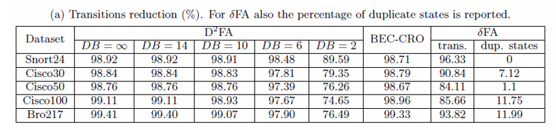
EXPERIMENTAL RESULTS
The compression in tab.3.a is simply expressed as the ratio between the number of deleted transitions and the original ones

Slide 28
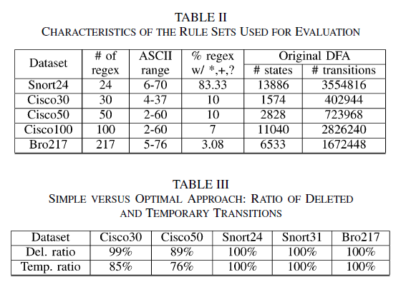
EXPERIMENTAL RESULTS

Slide 29
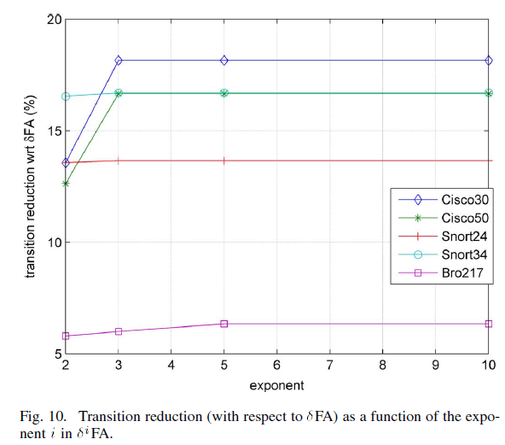
EXPERIMENTAL RESULTS
we move to the analysis of the effect of the “exponent” i of our δ^{i}FA.
the exponent represents the maximum depth of the DFS trees and hence the maximum order supported;

Slide 30
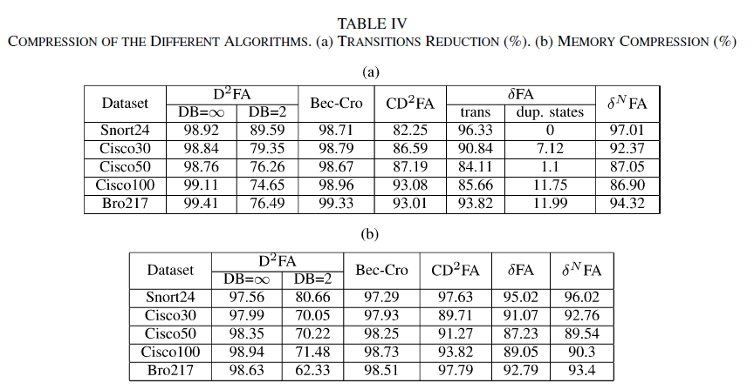
EXPERIMENTAL RESULTS
N=3
Notes:
越大越好，這個演算法的優點是在達到其餘方法的壓縮程度之於，有更快的 lookup 速度

Slide 31
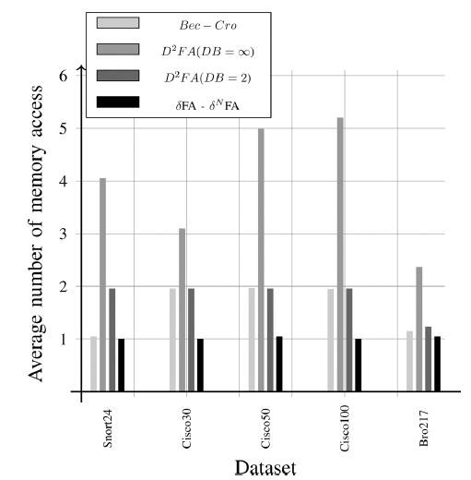
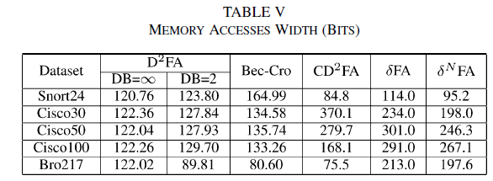
EXPERIMENTAL RESULTS
Table V reports the width of memory accesses for all evaluated algorithms in terms of average number of bits involved per state access.
Notes:
可是比的是 Memory Access

